Slide 1
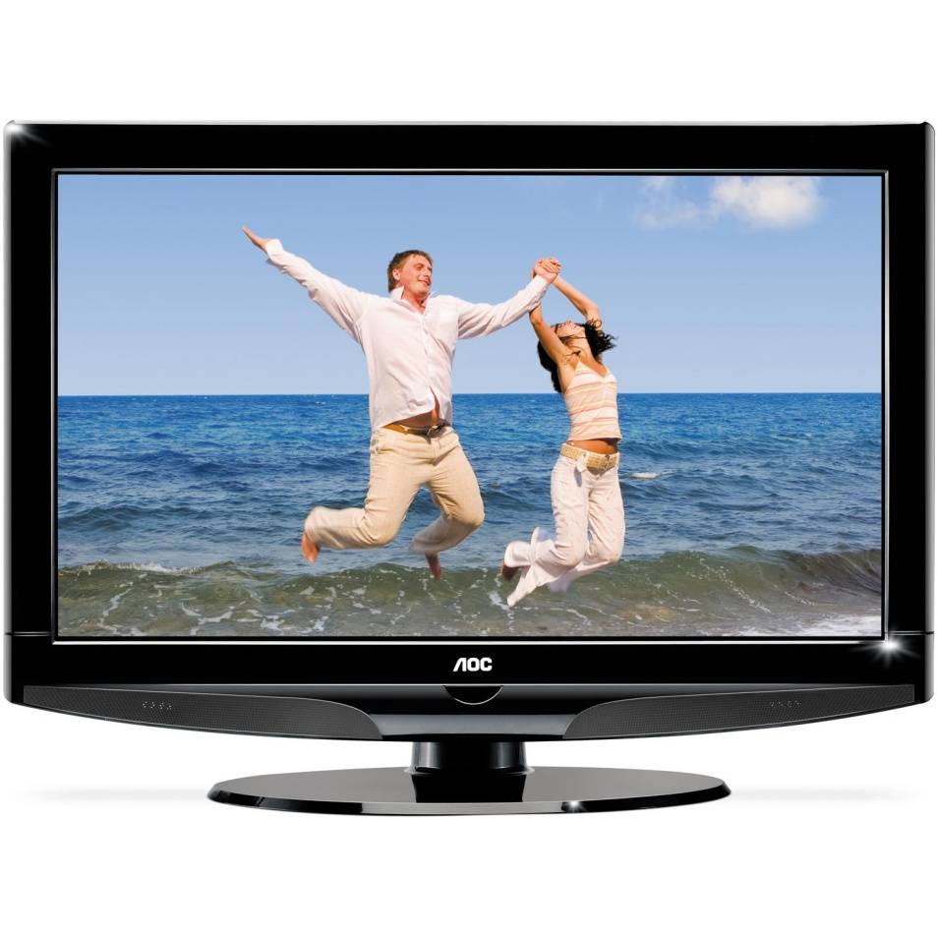
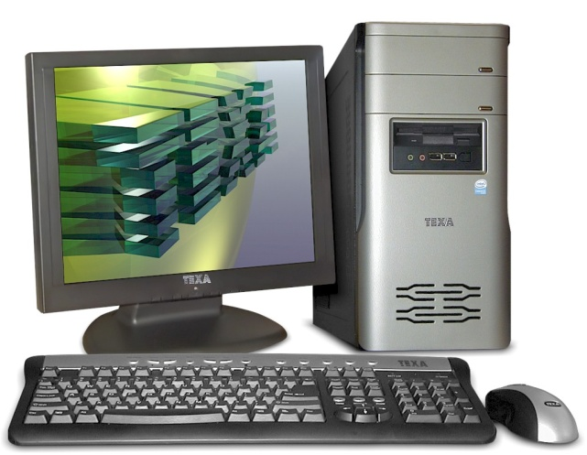
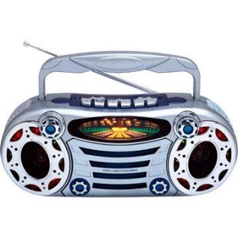
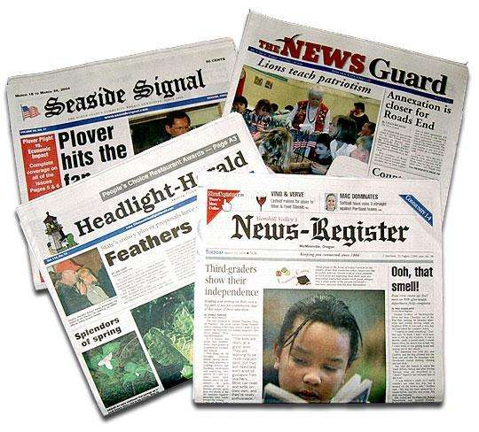
MEANS OF COMMUNICATION

Slide 2
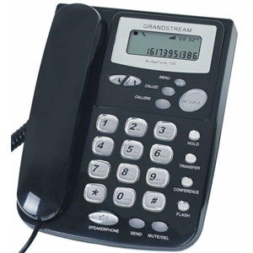
We use it to talk to other people
letter
telephone
magazine

Slide 3
Where do we watch movies?
We watch movies on the___________
Magazine.
Letters.
television

Slide 4
Where do we read the news?
We read the news in___________
television
newspapers
radio

Slide 5
Where do we listen to the news?
We listen to the news on the___________
radio
internet
telephone

Slide 6
It only has sounds, It has no images.
television
internet
radio

Slide 7
It has images and sounds.
television
internet
radio

Slide 8
It informs us with images, sounds and texts.
radio
internet
television

Slide 9
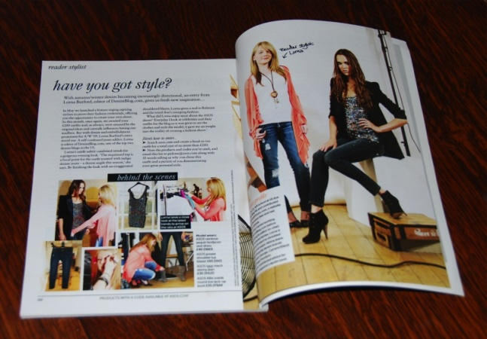
We can buy a __________ everyday.
Magazine.
Newspaper.
Letter.

